Slide 1


Company Value Case Analysis
AFC Ajax N.V. (Ticker: AJAX.AS)
Tachin Ho (Meek)

Slide 2

TABLE OF CONTENTS
01
Project Overview
02
Capital Structure Analysis
03
Financial Health & Performance
04
Intrinsic Valuation
05
Investment Recommendation
About Ajax / Choice of The Company
Debt-to-Equity Ratio / Cost of Debt and Equity / Impact of Interest Rates and Market Volatility
Key Financial Ratios / Analysis
Discounted Cash Flow (DCF) Analysis / Valuation Conclusion
Rationale / Risks / Recommendations / Impact of the Team Performance

Slide 3
01
Project Overview

Slide 4
About Ajax
Football Club Ajax (Dutch pronunciation: [ˈaːjɑks]), also known as AFC Ajax, Ajax Amsterdam, or simply Ajax, is a Dutch professional football club based in Amsterdam that plays in the Eredivisie. Ajax, named after the legendary Greek hero, is the most successful club in the Netherlands, with 36 Eredivisie titles and 20 KNVB Cups. And along with Feyenoord and PSV Eindhoven, is one of the country's "big three" clubs.

Slide 5
Why Ajax ?
I chose Ajax to explore how sports team operations impact stock value — a unique angle beyond typical firms.
Ajax balances youth development, competitive performance, and financial sustainability without big-club commercial power.
Ideal case to study the link between team performance, financial strategy, and shareholder value.
Notes:
I am interested in sports teams and how their operations affect their stock value, which is quite a unique topic I want to address. Ajax is an iconic club in Europe but not a top powerhouse like Manchester United or Real Madrid, making it more interesting to understand how financial management, player transfers, sporting success, and international competition participation influence stock performance. Studying Ajax offers a balanced perspective because the club must manage between developing young talent, maintaining competitive results, and ensuring financial sustainability without overwhelming commercial advantages. This dynamic makes Ajax an ideal case study to explore the relationship between on-field operations and shareholder value.

Slide 6
02
Capital Structure Analysis

Slide 7
Capital Structure Analysis
Ajax’s D/E ratio of 1.57 is in line with industry norms — more conservative than debt-heavy clubs like Juventus or Dortmund.
Leverage Level: Moderately leveraged — enough debt for flexibility, but not overexposed.
Interest Rates: Since Ajax has moderate debt, rising rates would slightly increase interest costs — but not enough to pressure their overall strategy.
Market Volatility: Much bigger impact — Ajax’s financial results swing more from on-field performance and transfer market dynamics than from changes in borrowing costs.
Total Liabilities (2024) | € 354.00 M
Total Equity (2024) | € 226.00 M
Debt-to-Equity Ratio | 1.57
Cost of Debt | 5.5%
Cost of Equity | 5.2%
Corporate Tax Rate | 25.8%
Debt Proportion | 61%
Equity Proportion | 39%
Debt Contribution (after tax) | 2.491%
Equity Contribution | 2.026%
WACC | 4.517%
Notes:
1. Below 1.0 = conservative / low leverageAbove 2.0 = aggressive / high leverageAjax’s 1.57 means it uses some debt, but equity still plays a big role — not too risky, not too passive. 2. Big clubs (like Juventus, Real Madrid) have stronger cash flow projections and bigger commercial deals, so they can borrow more.They also often fund stadium projects, player acquisitions, or wage bills through debt — betting on future income from trophies, sponsors, and broadcasting. 3. Rate Sensitivity: Moderate debt means rising interest rates have limited impact on financing costs. 4.Market Volatility Risk: Revenue depends heavily on transfer fees and Euro competitions, so financial planning is more exposed to football market fluctuations than loan terms.

Slide 8
03
Financial Health & Performance

Slide 9
Financial Health & Performance
Profitability down: ROE dropped from 17.95% to –4.21%; net margin fell to –6.42% in 2024.
On-field decline: Ajax finished 5th in 2024 — their worst league result in 10 years, missing out on European competition revenue.
Efficiency dropped: Asset turnover fell from 0.39 to 0.27; inventory turnover from 4.07 to 2.09.
Liquidity solid: Current ratio rose to 1.12; Ajax can still meet short-term needs.
Debt manageable: D/E ratio improved from 74% in 2022 to 48% in 2024.
Overall: Weaker performance and falling efficiency are pressuring financial health despite stable liquidity.
Ratio | 2024 | 2023 | 2022
Return on Equity (ROE) | –4.21% | 17.95% | –11.59%
Return on Assets (ROA) | –10.00% | –6.32% | –7.85%
Net Profit Margin | -6.42% | 19.85% | –12.85%
Current Ratio | 1.12 | 1.05 | 1.29
Quick Ratio | 1.07 | 1.00 | 1.25
Debt-to-Equity Ratio | 48% | 44% | 74%
Asset Turnover Ratio | 0.27 | 0.39 | 0.39
Inventory Turnover Ratio | 2.09 | 3.52 | 4.07
Notes:
Efficiency dropped:
Asset turnover fell from 0.39 to 0.27, meaning Ajax generated less revenue from its assets — likely due to lower matchday income and transfer revenue.
Inventory turnover dropped from 4.07 to 2.09, showing slower movement of merchandise or unused resources (e.g., player kits, gear, etc.).
Liquidity solid:
The current ratio increased to 1.12 in 2024, meaning Ajax has €1.12 in current assets for every €1 in liabilities — so it’s still in a safe zone for short-term obligations like salaries or operating costs.
Debt manageable:
Debt-to-equity improved from 74% in 2022 to 48% in 2024 — showing Ajax reduced reliance on debt and strengthened its equity base, likely through retained earnings or reduced borrowing.

Slide 10
04
Intrinsic Valuation

Slide 11
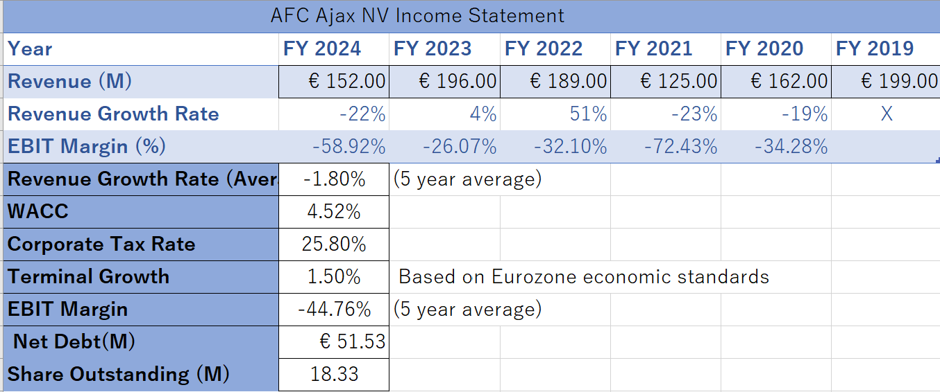
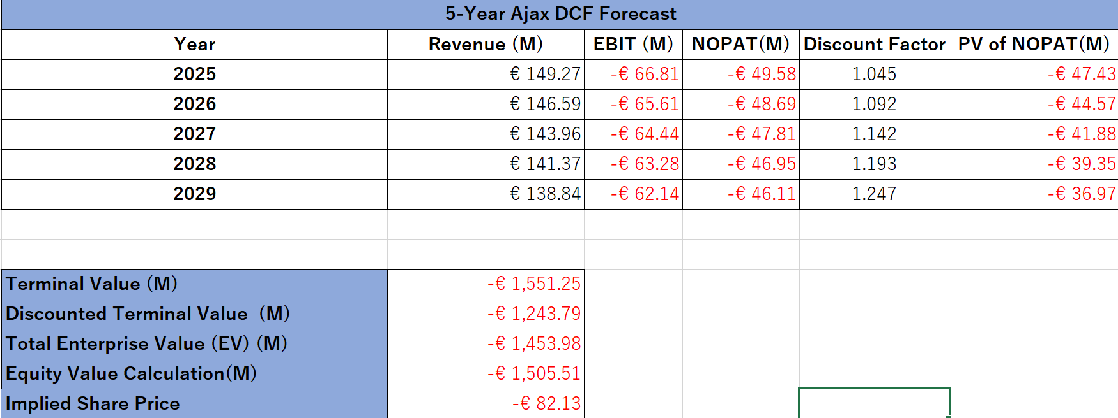
Discounted Cash Flow (DCF) Analysis

Slide 12
DCF Model Inputs
Valuation Results
Projected Free Cash Flows (2025–2029): Based on declining revenue and negative EBIT Terminal Value: –€1,551.25M Discounted Terminal Value: –€1,243.79M Total Enterprise Value: –€1,453.98M Net Debt: –€51.53M Equity Value: –€1,505.51M Implied Share Price: –€82.13
Revenue Growth Rate: -1.84% (5-year average)
Starting Revenue (2024): €152M
WACC : 4.52%
Corporate Tax Rate : 25.80%
Terminal Growth : 1.50%
(Based on Eurozone economic standards)
EBIT Margin: -45.58% (5-year average)

Slide 13
Stock Rating & Outlook
Implied Share Price: −€82.134
Market Price (2025/4/28) :
€9.96
Analyst Consensus: Hold, with an average target price of €9.00.
Notes:
Negative, indicating that the intrinsic value per share is below zero under current assumptions.

Slide 14
Why Hold ? A Potential 2025 Winning Season
Brand remains strong
Turnaround possible
Ajax still holds value through youth development and fan trust.
Selling now may lock in losses,
also, a potential promising 2025 season could quickly improve financials.
Notes:
Volatility ≠ worthlessness: Performance-driven income could rebound — “Hold” is a cautious, reasonable call.

Slide 15
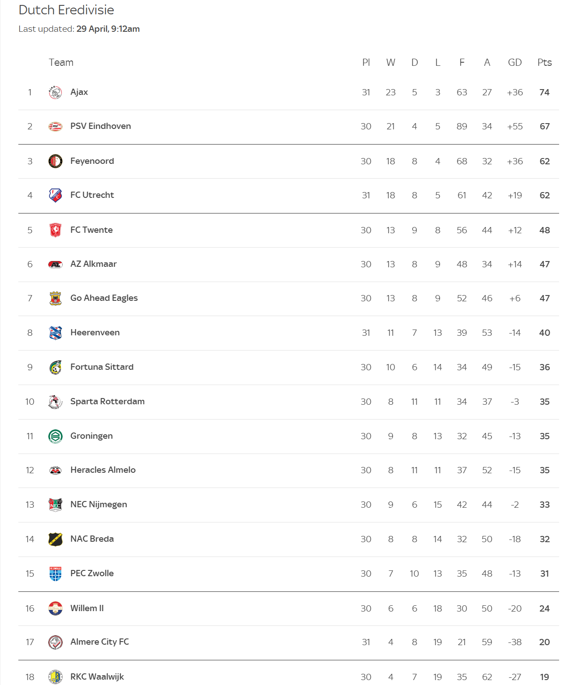
Dutch Eredivisie Table 2025

Slide 16
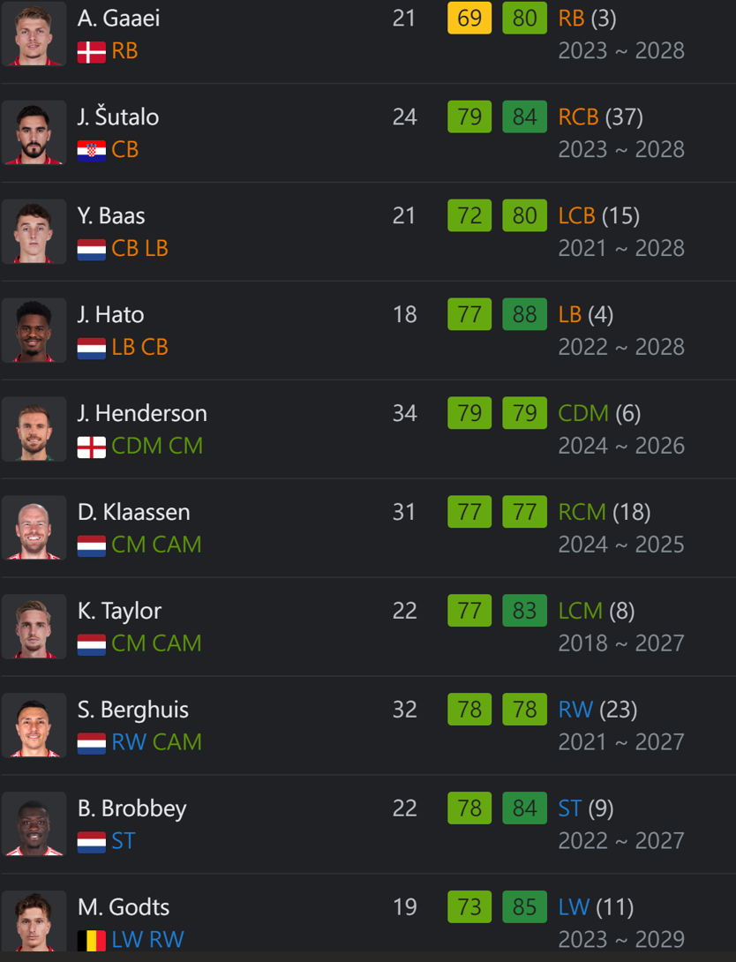
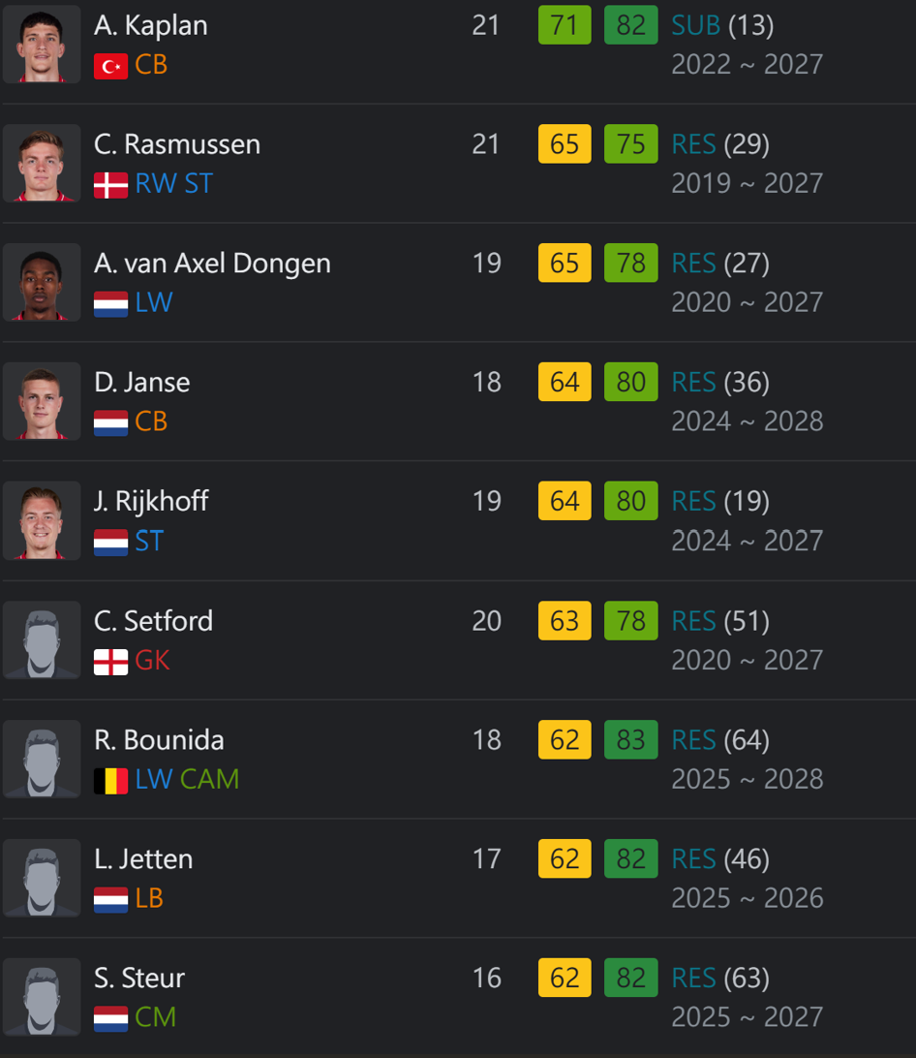
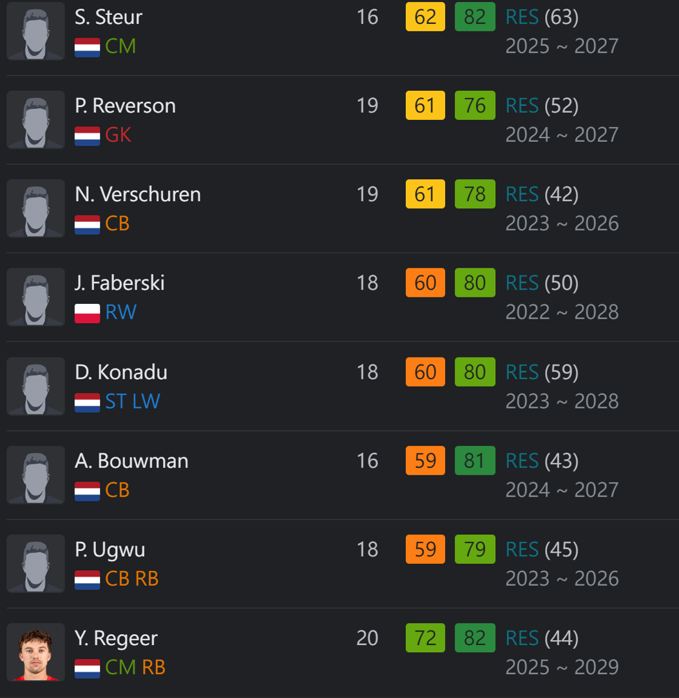
Strong Youth Prospects

Slide 17
Valuation Conclusion
DCF result
Market optimism
Negative equity
2025 outlook
Ajax appears significantly overvalued based on current financials.
Current price reflects hope for a rebound — stronger player development and European competition success.
Driven by ongoing losses and declining revenue.
Investors may be pricing in a potential Eredivisie title push.

Slide 18
05
Investment Recommendation

Slide 19
Strategy Insight
Rationale
Ajax has a strong brand, solid equity, and a world-class youth system.
But current financials show warning signs: • EBIT margin: –45.58% • Revenue growth: –1.84% avg • Heavy reliance on transfer income and European competition
Upside is limited without a strong performance rebound.
Key Risks
Performance Risk: Missing top 3 or Europe hits revenue hard.
Transfer Risk: Profits depend on selling players at the right time, for the right price.
Operational Risk: High wages and fixed costs can squeeze cash flow.

Slide 20

Recommendations
Grow commercial income
Control costs smartly
Double down on youth
Boost global branding and merchandise sales.
Cut admin and wage bloat without hurting squad quality.
Keep developing talent to stay competitive and profitable.
Notes:
Recommendations: Investment Opinion “Hold”
•Diversify Revenue Streams: Invest in commercial activities, merchandising, and global branding to reduce reliance on variable income.
•Cost Management: Implement stringent cost controls, particularly concerning player wages and administrative expenses. Although this might affect the player acquisition which might lead to give up attracting star payers in transfer market. Keep balance between player wages control and improving roster strength.
•Youth Development: Continue focusing on the youth academy to develop talent internally while maintaining team strength to be strong contender in both domestic league and Euro series, which also affect the stock market dramatically.

Slide 21
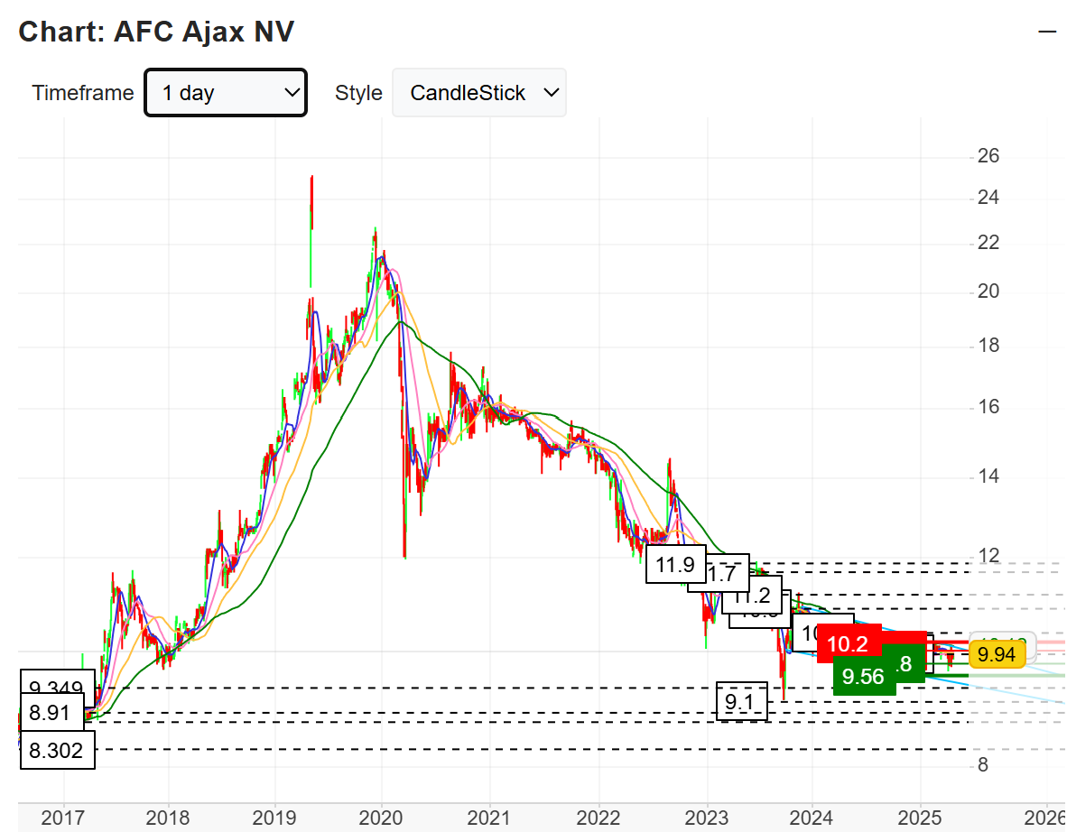
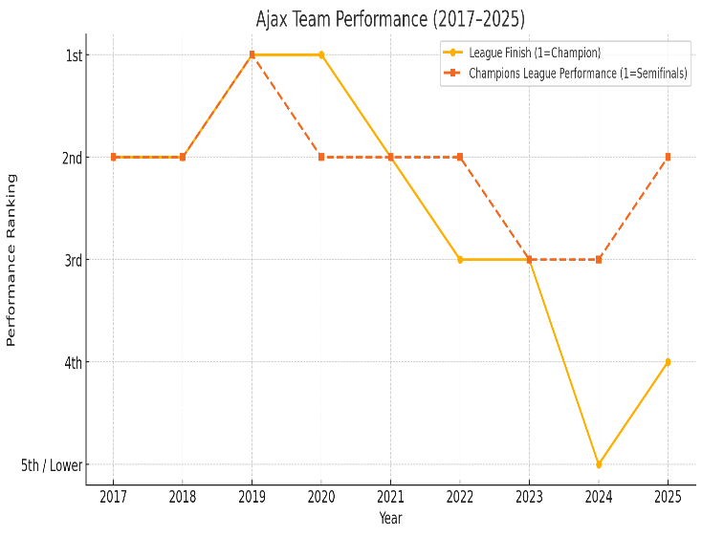
Impact of the Team Performance
Ajax’s stock peaked during the 2018–19 UCL semifinal run and hit a historic low after finishing 5th in 2024.
Performance has a direct impact on revenue, investor confidence, and market value.
Strong results drive ticket sales, transfer value, and financial momentum — poor performance does the opposite.
Notes:
Managing both sporting success and financial strategy is key to long-term stability.

Slide 22

THANKS!
Do you have any questions?
tho12@hawk.iit.edu

